Slide 1
Asking What No One Has Asked Before :
Using Phrase Similarities To Generate Synthetic Web Search Queries
CIKM’11
Advisor：Jia Ling, Koh
Speaker：SHENG HONG, CHUNG

Slide 2
Outline
Introduction
Generating new queries
Aggregation into query templates
Generation of candidate phrase fillers
Filtering of candidate phrase fillers
Experiment
Conclusion

Slide 3
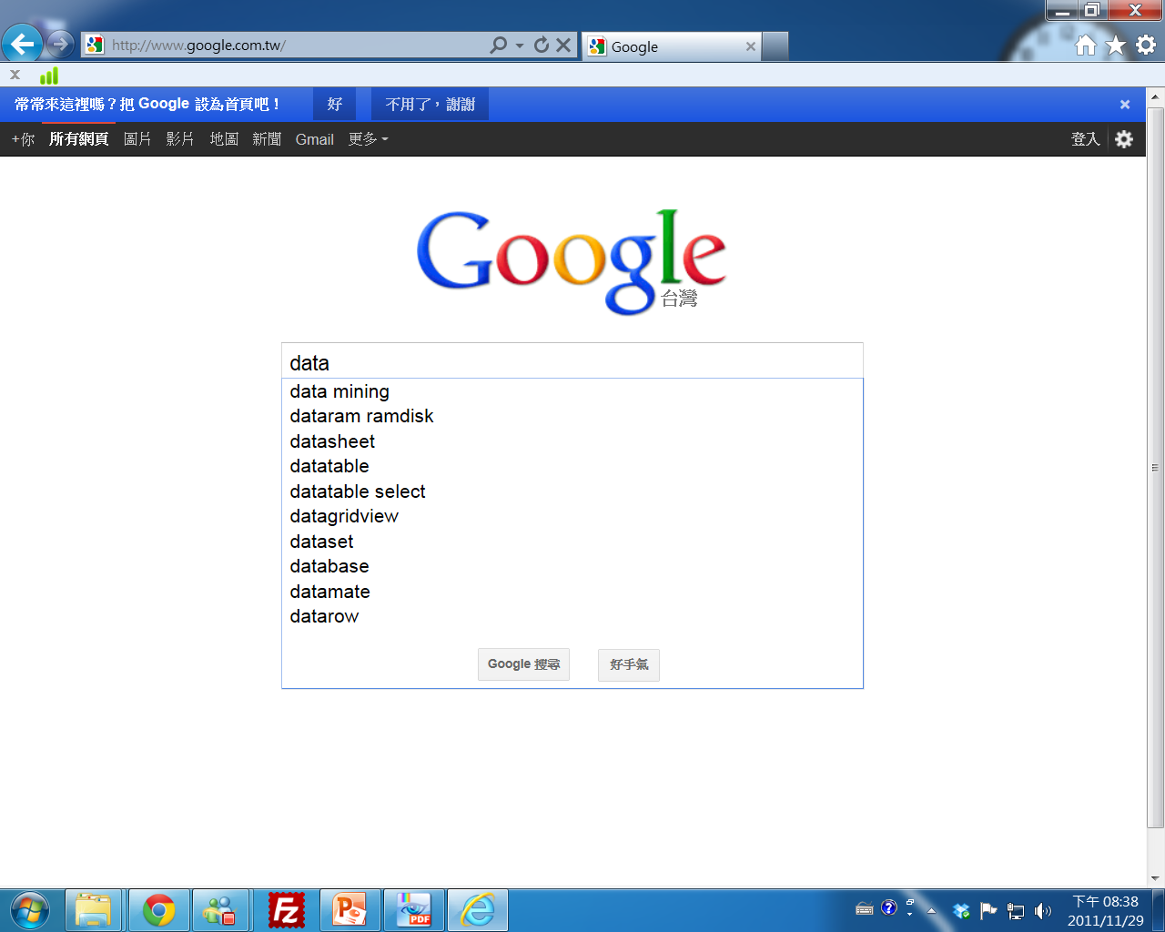
Introduction
Introduces a method for automatically inferring meaningful, not-yet-submitted queries.
Known queries
Others’ query log recommendation
If the query isn’t in the known queries set ?

Slide 4
Introduction
Motivation
enrich the sets of queries displayed as potential completions based on what Web search users have typed so far, reducing the time to search result.
Benefit for natural-language QA system

Slide 5
Introduction
query
Q1
Q2
Q3
.
.
.
.
.
Query template
Known phrase
“lyrics of hey jude beatles”
“lyrics of come together beatles”
“lyrics of yesterday beatles”
lyrics of beatles
:{yesterday, hey jude, come together}
Expand and filtering

Slide 6
Generating new queries
Deﬁnitions:
A query Q is a sequence of tokens Q=[q₁,q₂…,q_{i},...q_{NQ}], submitted as a search query by Web users.
A query template T is a generalization of a set of queries that share a common preﬁx and common postfix.
A template signature T_{S} is a generalization of a set of query templates that, if their token sequences are reduced to token sets, become the same. Some tokens that belong to a ﬁxed, global set of tokens deemed irrelevant may be discarded in the process.

Slide 7
Generating new queries
Q_{a} = “lyrics of hey jude beatles”
q₁ q₂ q₃ q₄ q_{5a}
prefix, non-empty infix, postfix
lyrics, of hey jude, beatles
lyrics of, hey jude, beatles
lyrics of, hey, jude beatles
.
.
.

Slide 8
Aggregation into query templates
“lyrics of hey jude beatles”
“lyrics of come together beatles”
“lyrics of yesterday beatles”
lyrics of beatles
Query template
:{yesterday, hey jude, come together}
Known phrase fillers

Slide 9
Generation of candidate phrase fillers
Let DS(K_{i}) be the list of most distributionally similar phrases of a known phrase ﬁller K_{i} from a query template T .
Any phrase U from DS(K_{i}) is considered as a candidate phrase ﬁller U of the respective query template. The score of U relative to the entire set of known ﬁllers

Slide 10
Generation of candidate phrase fillers
lyrics of beatles
Query template : T
:{yesterday, hey jude, come together}
DS(K₁)
U₁
U₂
U₃
.
.
DS(K₂)
U₁
U₃
U₄
.
.
DS(K₃)
U₂
U₃
U₄
.
.
DS(K_{i}) = { U₁,U₂,U₃,U₄ }
Candidate phrase filler
Sim(U₁,T) = ( DSscore(U₁,K₁)+DSscore(U₁,K₂)+DSscore(U₁,K₃) ) / 3
Sim(U₂,T) = ( DSscore(U₂,K₁)+DSscore(U₂,K₂)+DSscore(U₂,K₃) ) / 3
Sim(U₃,T) = ( DSscore(U₃,K₁)+DSscore(U₃,K₂)+DSscore(U₃,K₃) ) / 3
For each template T , its candidate phrase ﬁllers U are ranked in decreasing order of their scores.

Slide 11
Dsscore → similarity function → Cosine similarity
Sim(U₁,T) = ( Cos(U₁,K₁)+Cos(U₁,K₂)+Cos(U₁,K₃) ) / 3
Sim(U₂,T) = ( Cos(U₂,K₁)+Cos(U₂,K₂)+Cos(U₂,K₃) ) / 3
Sim(U₃,T) = ( Cos(U₃,K₁)+Cos(U₃,K₂)+Cos(U₃,K₃) ) / 3
DS(K_{i})
Feature 1 : context
Feature 2 : context
Feature 3 : context
.
.
.
word
Feature vector
Pair similarity(word_{i}, word_{j})
Top-K
word1
.
.
.
word_{k}
word_{i}
Feature clustering
Similar list

Slide 12
Filtering of candidate phrase fillers
A canonical, keyword-based template signature T_{S} tokens
Stopwords
POS tagging
prepositions (of, for)
determiners (the, an)
auxiliary verbs (have, were)
typical initial words in questions (who, how, where).
The tokens not discarded are stemmed and ordered lexicographically in T_{S} .

Slide 13
Filtering of candidate phrase fillers
lyrics of beatles | beatl lyric
lyrics the beatles
beatles lyrics
lyrics for by the beatles
by beatles lyrics
lyrics by the beatles

Slide 14
Filtering of candidate phrase fillers
The list of candidate phrases of T is ﬁltered, by retaining only known phrases of some other templates T that share the same template signature T_{S} as T.

Slide 15
Filtering of candidate phrase fillers
Candidate phrase fillers of
“lyrics of beatles :”
“lyrics the beatles ”
eleanor rigby
lucy in the sky with diamonds
Unfiltered list
something,
earlier today,
last friday,
Gather together,
eleanor rigby,
two weeks ago,
lucy in the sky with diamonds,
strawberry ﬁelds forever,
something else,
here comes the sun,
lovely rita.
“beatles lyrics ”
lovely rita
here comes the sun
Filtered list
eleanor rigby
lucy in the sky with diamonds
lovely rita
here comes the sun

Slide 16
Experiment
Data Sources: The experiments rely on a random sample of around 100 million fully-anonymized queries in English submitted by Web users to Google in 2010.
A phrase similarity repository is available.
Derived from unstructured text available within a sample of around 200 million documents in English.
The repository provides data for each of around 1 million phrases that occur as full-length queries in the input query logs.
It contains ranked lists of the top 200 phrases computed to be the most distributionally similar

Slide 17
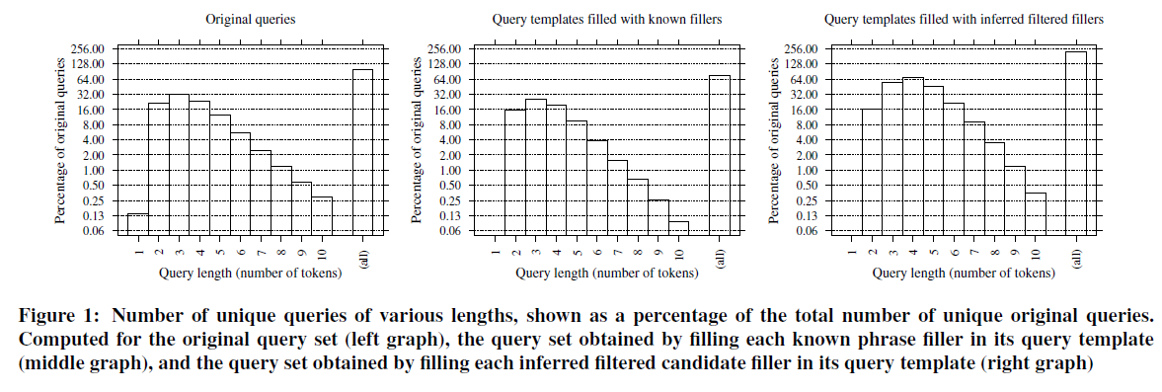
Experiment
Relative Coverage for Inferred Queries:
Left graph : the distribution of unique queries over query length in the input query logs.
Middle graph : the distribution of original queries that contribute to the creation of any query template and one of its known ﬁllers.
Right graph : is for inferred ﬁltered queries, which do not include any of the original queries among them.

Slide 18
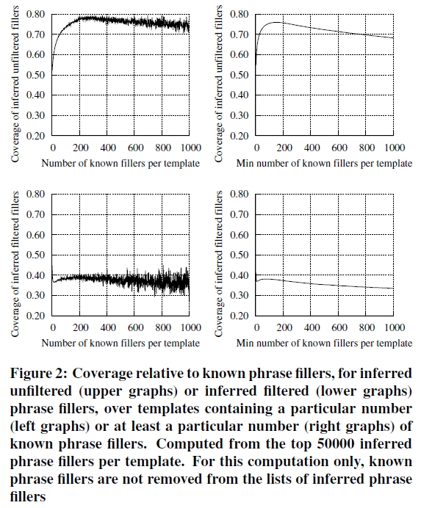
Experiment
Relative Coverage for Inferred Phrase Fillers:
the coverage over all query templates, computed as the percentage of known ﬁllers that occur among inferred ﬁllers.

Slide 19
Experiment
a random sample of 800 TREC questions is manually inspected.
resulting question templates would be so general
What is a fuel cell? (158)
If the question is too specific to generate any new queries from its possible templates
In what year did joe dimaggio compile his 56-game hitting streak? (139)
Other questions
A total of 503 of the 800 questions are thus converted into 457 unique question templates.

Slide 20
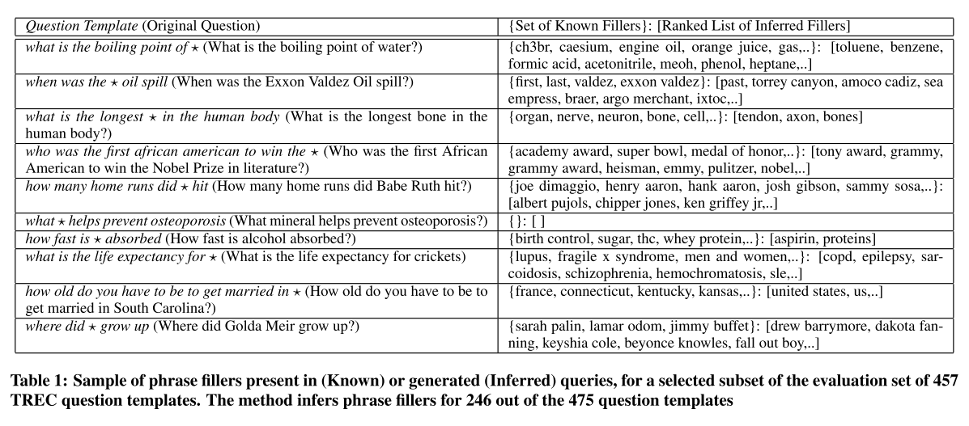
Experiment

Slide 21
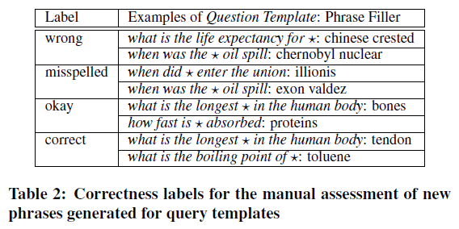
Experiment
Quality of Inferred Queries
Each phrase is manually assigned a correctness label within its respective query template
Correct : it is a meaningful filler of the template
Okay : it refers to a concept that would be a meaningful filler but as it stands grammatically disagrees with the template
Misspelled : it is a meaningful filler but is misspelled
Wrong : it is not a meaningful filler.

Slide 22
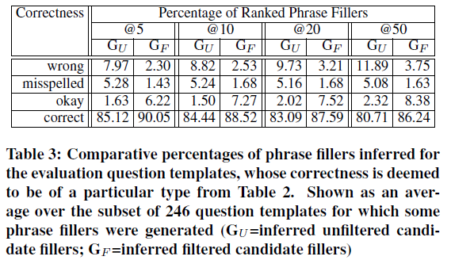
Experiment

Slide 23
Conclusion
Redundancy within Web search queries allows for the generation of not-yet-submitted queries that correspond to meaningful user information needs.
The analysis of query logs is limited to queries considered in isolation from one another; no search-result clicks or query sessions are needed.

